Slide 1

Innovation
Key to Business in
Germany

Slide 2

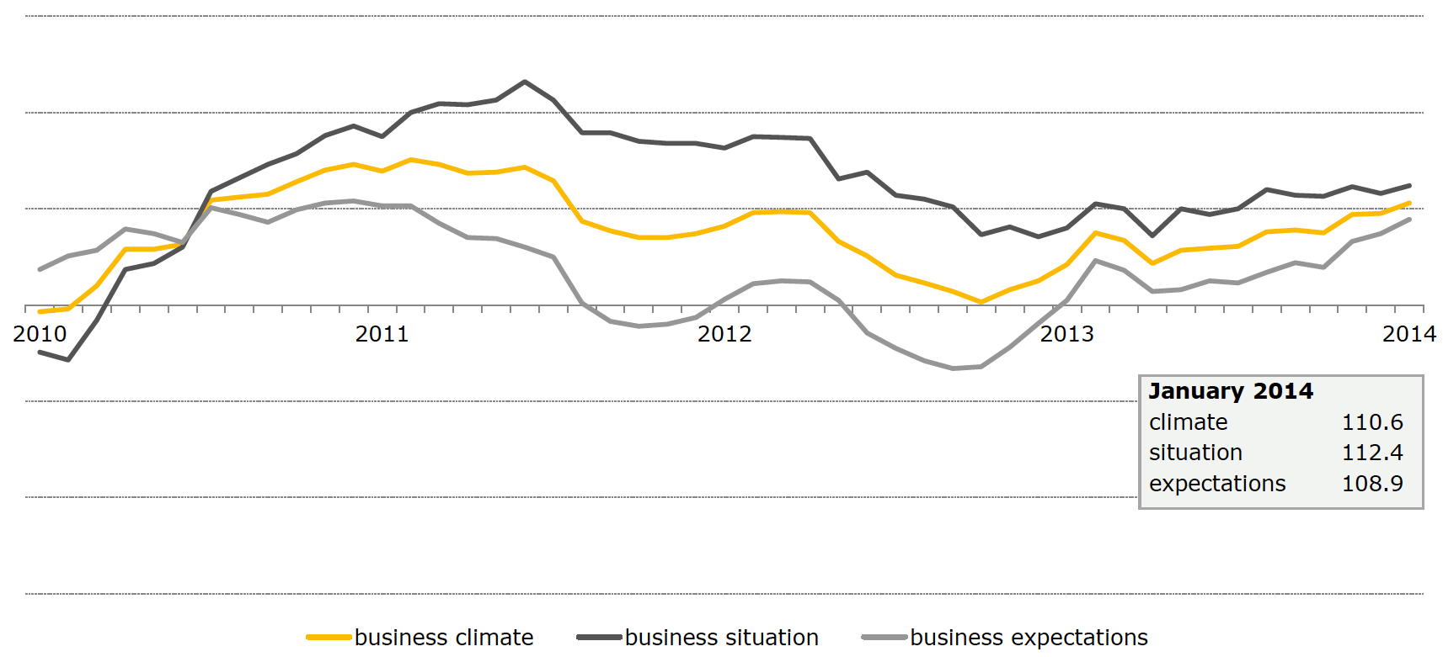
Ifo Business Climate Index
(Jan 2010 – Jan 2014, 2005 = 100)

Slide 3
Ratio R&D-Expense to GDP

Slide 4
Product and Process Innovators
(2002 – 2012)

Slide 5
Relevant Patents for the Global Market

Slide 6
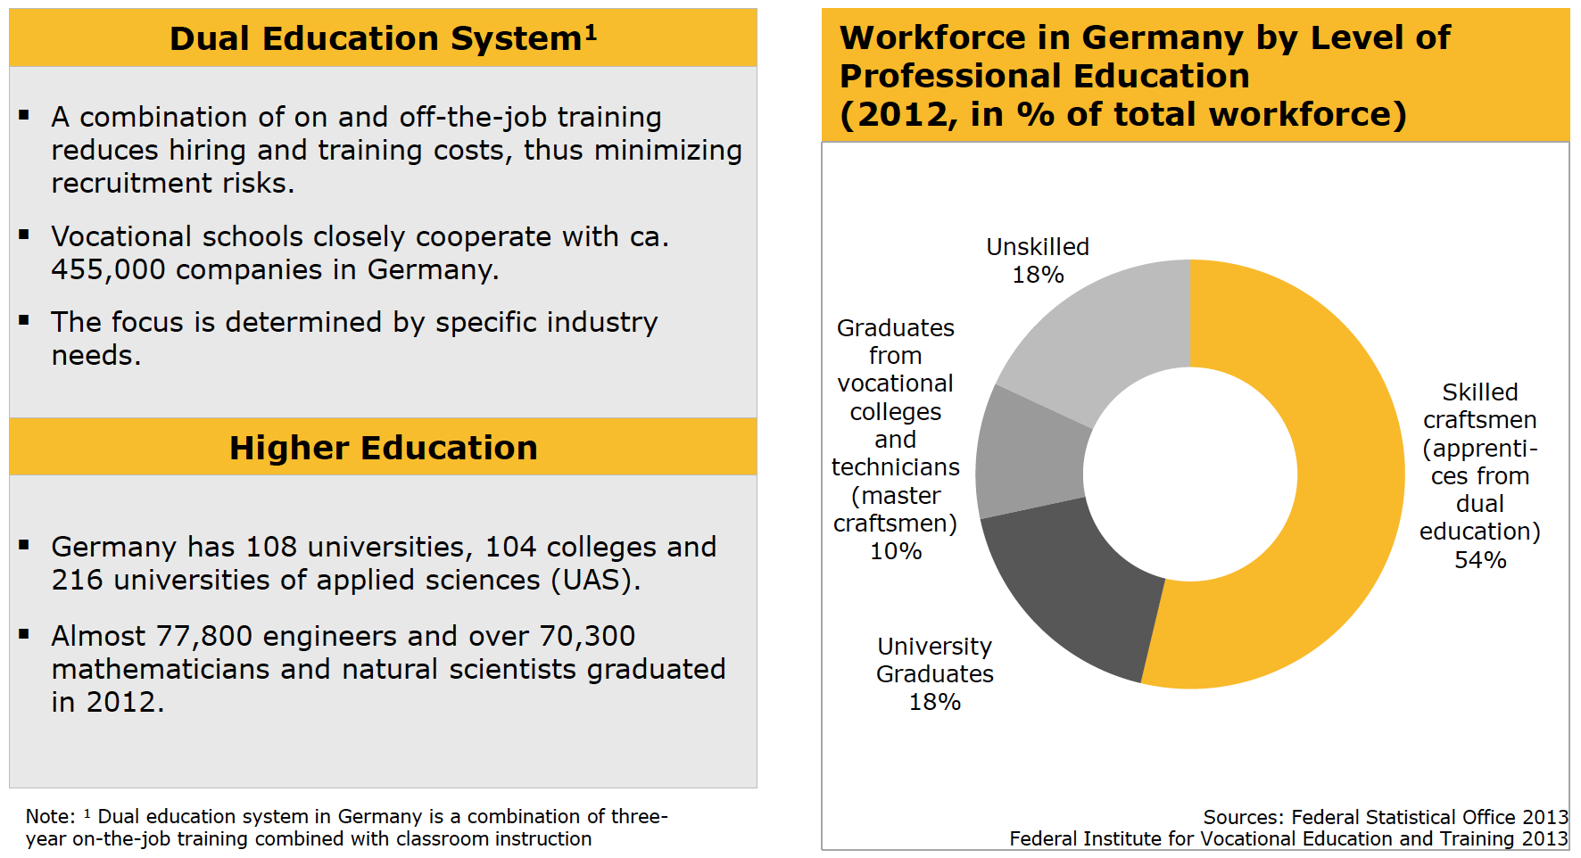
Skilled Workforce

Slide 7

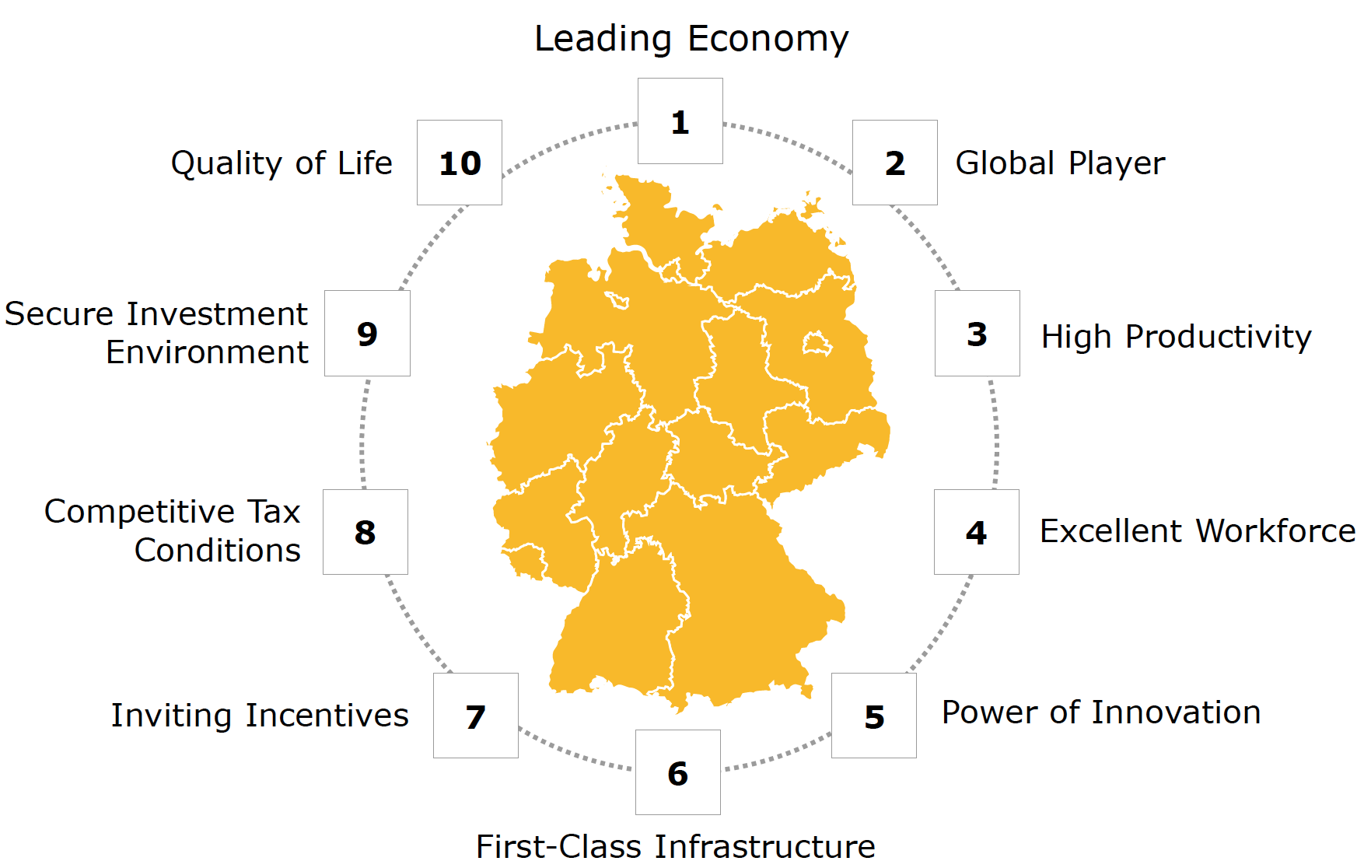
Excellent investment location creates innovation

Slide 8
Thank you.

